Slide 1
Assignment #1: Needfinding

Slide 2

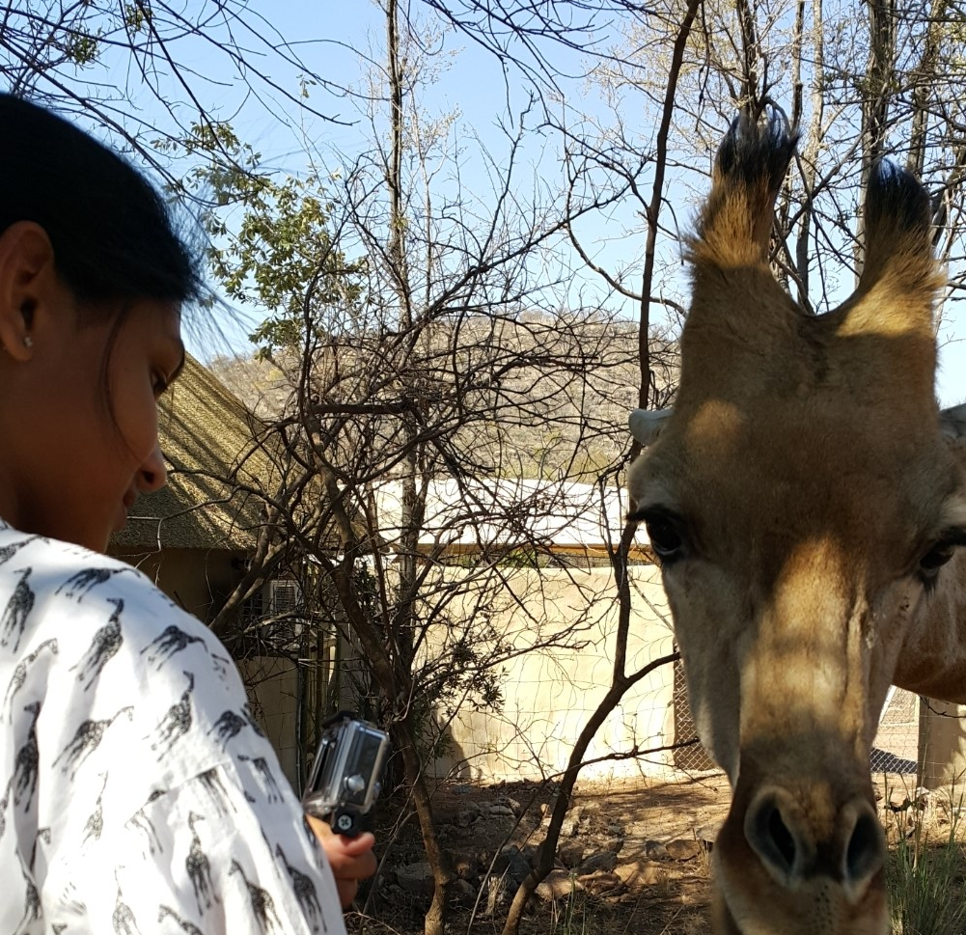
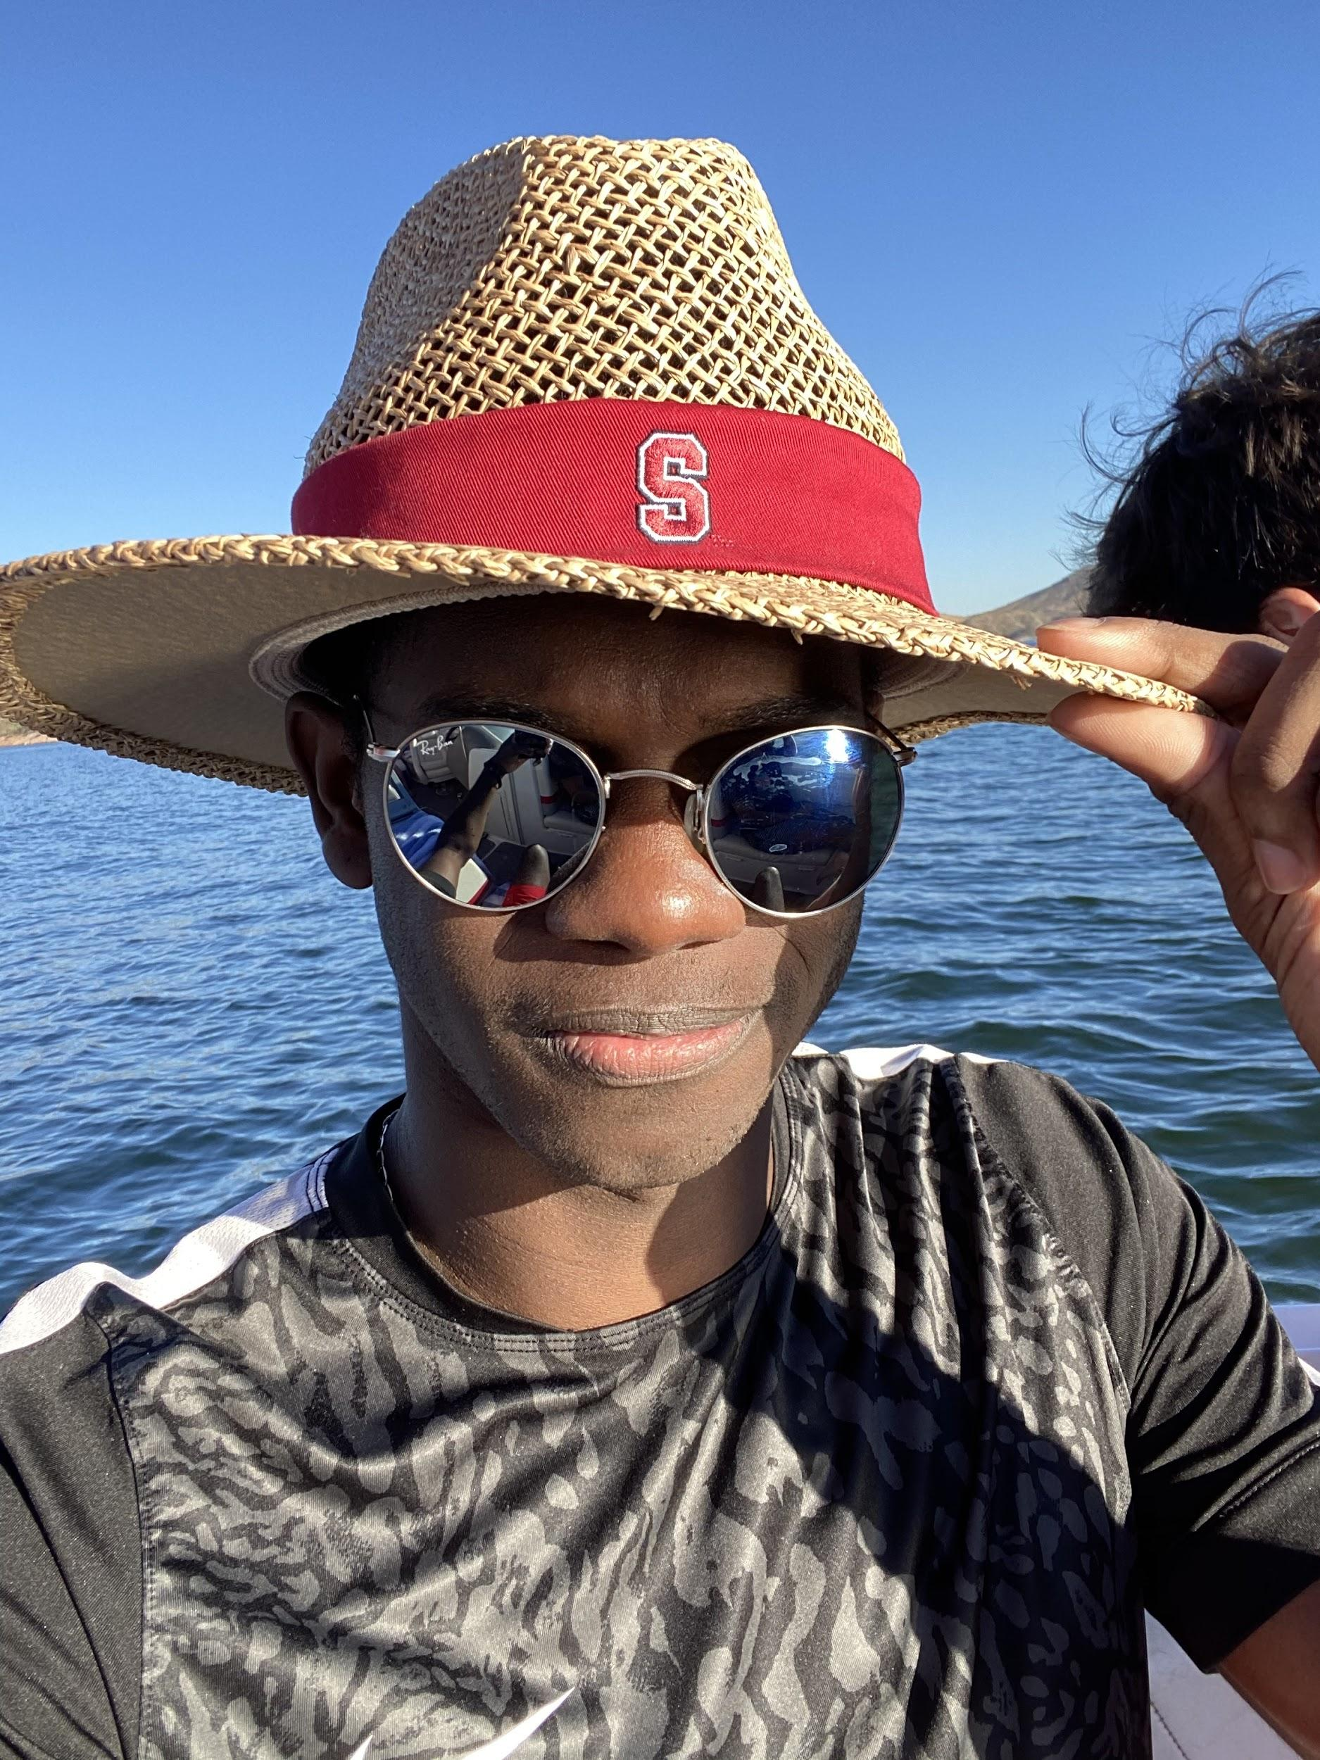

Our Team
Problem Domain: Financial Health and Literacy
Kaili Wang
Computer Science
HCI Track
B.S. ‘22
Kiara Nirghin
Computer Science
BioComp Track
B.S. ‘22
Robert Ross
Computer Science
AI Track
B.S. ‘21 M.S. ‘22
George Younger
Computer Science
AI Track
B.S. ‘20 M.S. ‘21

Slide 3
1.
Needfinding Methodology
A total of four different interviews

Slide 4
Interview : Andrew
PROFILE: Leave of absence from Trinity University to pursue business
WHY: Extreme user (entrepreneur, experiences w/ taxes and finance)
RECRUITED: Roommate
WHERE: Kitchen during dinner
QUESTIONS:
How did you learn about finance (personal and enterprise)?
Tools used for business (pros and cons)
Spending patterns

Slide 5
Interview : Eleonor
PROFILE: Rower and junior at Clemson University
WHY: No previously shown interest in personal finance, but is close to starting a full-time job
WHERE: Zoom (in her house)
RECRUITED: high school classmate
QUESTIONS:
Tell me about a time you were proud of or regretted a financial decision.
Where do you learn about personal finance?
What got you recently more interested in personal finance?

Slide 6
Interview : Will
PROFILE: Senior at Georgia Tech studying Computer Science
WHY: Least knowledge of personal finance, but had shown interest
WHERE: Zoom
RECRUITED: High school classmate
QUESTIONS:
Are you concerned about the data shared with financial applications?
Why did you choose your financial applications?
Where do you learn about finance and who do you talk to?

Slide 7
Interview : Kaiulani (Kai)
PROFILE: Highschool graduate, has not attended college
WHY: Has not attended college, self-taught, financially supported by parents
WHERE: Zoom (in her house)
RECRUITED: friend of a friend
QUESTIONS
What has been your experience with personal finance with your parents?
How do you and your friends perceive financial technology?
Are there any new financial trends that you think younger people are joining?

Slide 8
2.
Interview Results
What we ended up finding out?

Slide 9
Discussion of Results
Many feel that they are thrown into the world having to manage their finances (taxes and budgeting)
There's so much to learn that they feel stupid and overwhelmed, and therefore less willing to go out and learn
Most common sources of information: internet & family members
Personal banking apps seem to be the most common mobile sources for financial info

Slide 10
Surprises
All interviewees learned finance from their dads
Only one person had any idea how to do taxes (Andrew)
Gen Z individuals are more "open" with their finances in their communities
For half of the interviewees, almost all of their money was in a checking account
Younger individuals value income diversification

Slide 11
"Even with all the guidance I had, I didn’t have a lot of the information I needed"
-Kaiulani

Slide 12
3.
Analysis
What we ended up finding out?

Slide 13
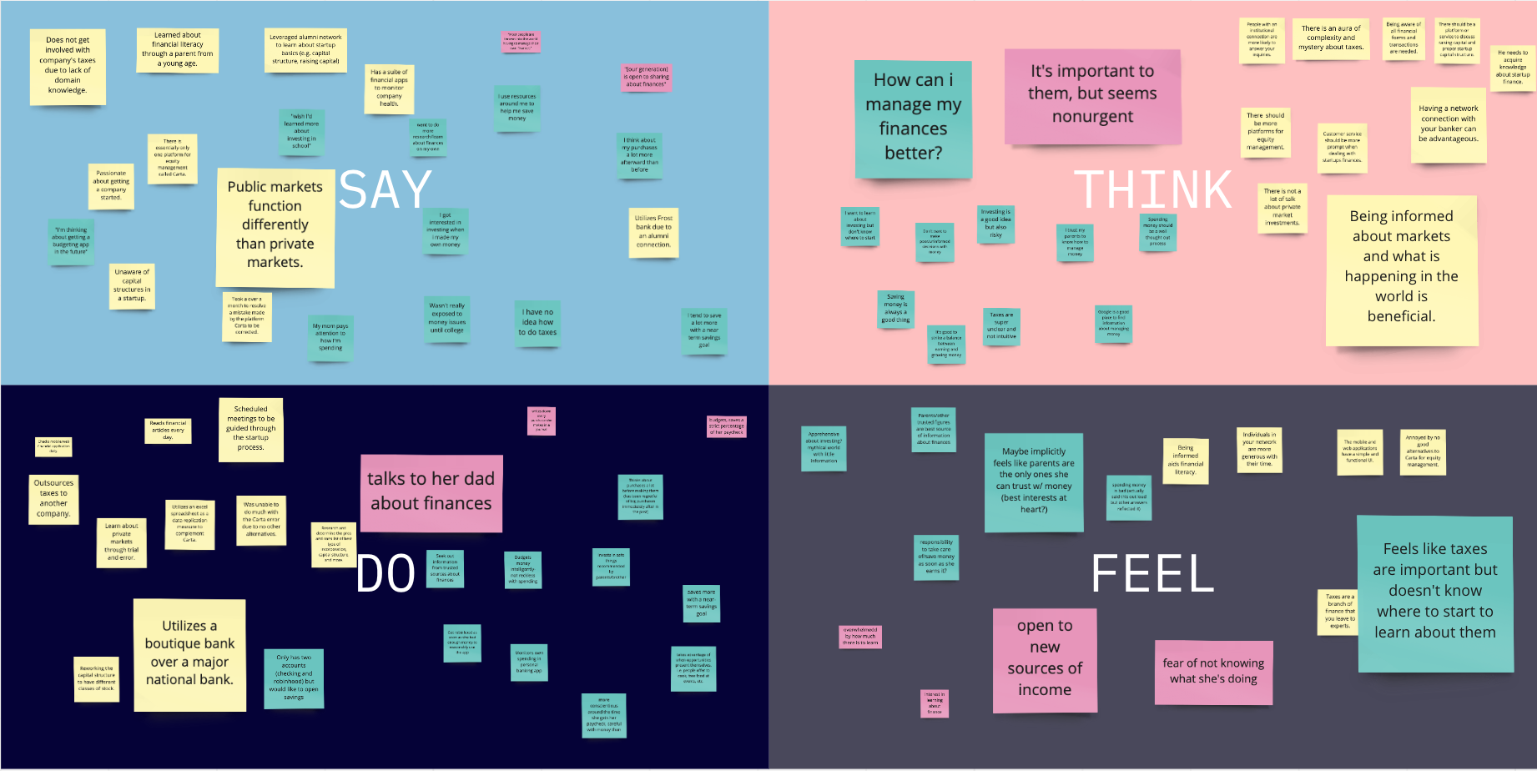
Empathy Map

Slide 14
Tensions, contradictions, surprises in our interviews:
Tensions and Contradictions
Surprises
They learned most of their finances from their dads
Interviewees very open to discussing finances with each other
Importance of finance
Taxes are ubiquitous
People start to learn more
Want to avoid risk
vs
don’t know much
no clue how to do them
more intimidated by how much is out there
risk is needed for investing
vs
vs
vs

Slide 15
Inferences, conclusions, and questions:
Inferences
Young adults don’t know the best way to sort and process financial news and trends
Knowledge gap between parental guidance and current financial markets
Conclusions
Financial literacy is valued yet unattained
Fintech mobile applications are the finance medium for Gen Z
Many people do not understand taxes well
Questions
How can we overcome the initial friction of learning about finances?
Why is Gen Z more open about personal finances?
Notes:
“There’s only so much you can learn from your parents

Slide 16
Initial assessment of “needs” and “insights”:
Needs
Financial information that is more digestible to young people
A way to understand and engage with new financial trends
Engage with more experienced people to learn about finances
Insights
Young people still want to engage with finance in the most reliable means
Still a focus on diversification and long-term planning of finances with young people

Slide 17
4.
Summary
Roundup of our findings

Slide 18
Final Summary
Our interviews ended up being focused on a younger audience
There were key issues identified with regards to access of financial information and trends
Clear desires to learn more earlier, have finances taught in school
Opportunity to tap into young people’s willingness to discuss finances with each other

Slide 19
Thanks!
Any questions?
Kaili Wang, George Younger, Robert Ross, Kiara Nirghin

